Slide 1
Bioinformatics

Slide 2
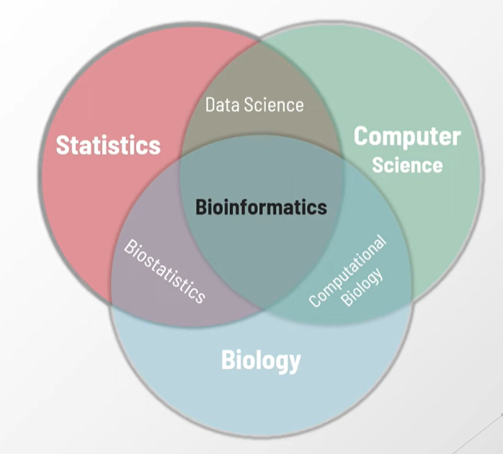
What is Bioinformatics?
Bioinformatics is
an interdisciplinary field of science in which biology,
statistics/mathematics, computer science and information technology merge together to form a single discipline in order to analyze biological information using computers and statistical techniques.
Biological experiments can generate large amounts of data (macromolecular sequences, structures, expression profiles, pathways and so on.)
●
Bioinformatics is about acquiring/ collecting, managing, analyzing and understanding those data.
Also termed as biocomputing or computational Biology.

Slide 3
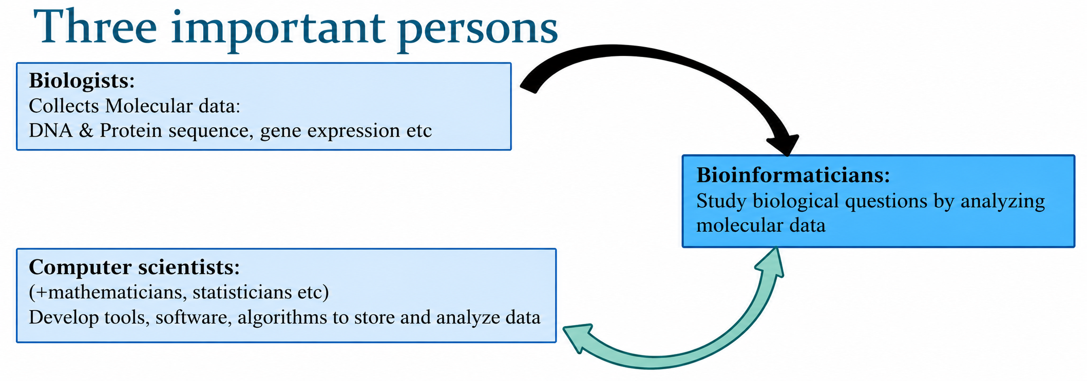
What is Bioinformatics?

Slide 4
What is Bioinformatics?
Explanation of the Diagram
Biologists
  Collect molecular data.
  Examples: DNA sequences, protein sequences, gene expression profiles, experimental results.
  Provide the raw biological information that forms the basis for further analysis.
Computer Scientists (with Mathematicians & Statisticians)
  Develop computational tools, software, databases, and algorithms.
  Enable the storage, processing, and large-scale analysis of massive biological datasets.
Bioinformaticians
  Bridge the gap between biology and computer science.
  Use computational methods to study biological questions—e.g., finding disease-causing genes, predicting protein structures, or analyzing evolutionary relationships.

Slide 5
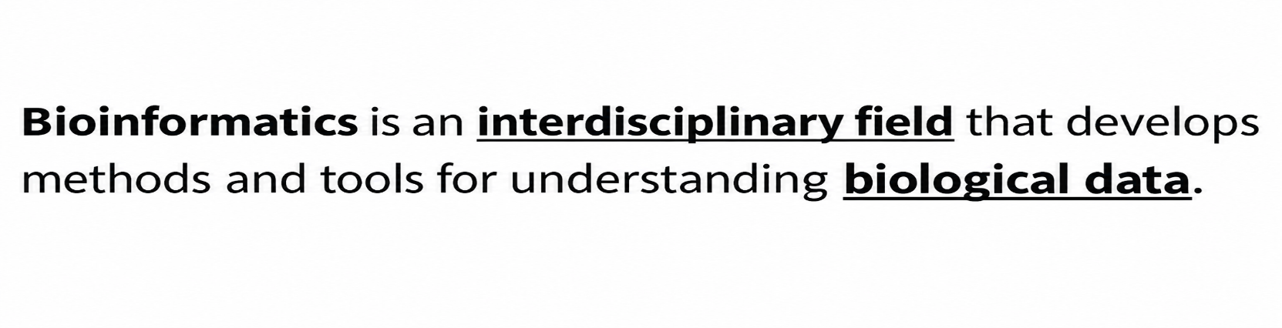
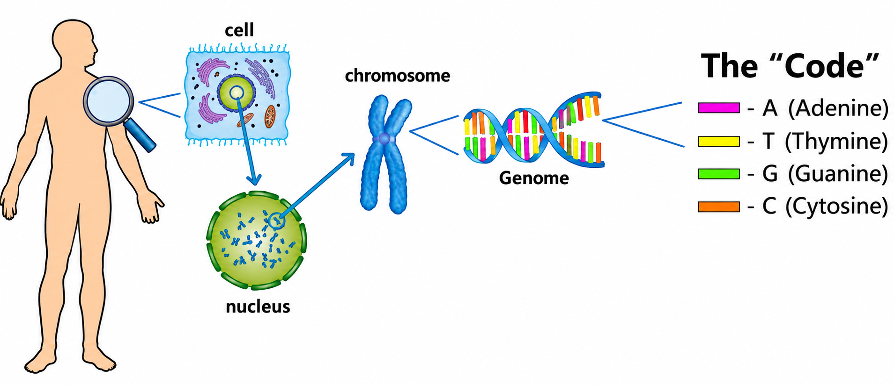
Biological data

Slide 6
Biological Data
The genome or DNA, often called the “book of fate,” is a complete set of instructions written inside every cell of our body. Just as a book is made up of chapters, paragraphs, and sentences, our genome is composed of genes, sequences, and nucleotides. Within it lies the information that determines much of who we are—our gender, the height to which we may grow, the color of our eyes and skin, and even our resistance or susceptibility to certain diseases.
For centuries, this book remained closed to us. The sheer vastness of the human genome, with its billions of DNA letters, made it appear impossible to read and understand. However, recent decades, particularly with the completion of the Human Genome Project and advances in sequencing technologies, have allowed scientists to gradually “read” this book. What once seemed like an undecipherable mystery is now becoming a map that guides medicine, genetics, and our understanding of life itself.

Slide 7
Human Genome Project
Human Genome Project (HGP)
The Human Genome Project was an international scientific research effort that aimed to map and understand all the genes of human beings—collectively known as the genome. It officially began in 1990 and was completed in 2003, two years ahead of schedule.
The main goals of the HGP were to:
Identify all the genes in human DNA (estimated to be about 20,000–25,000).
Determine the sequence of the 3 billion DNA base pairs that make up the human genome.
Store this information in databases to be accessible for research.
Improve tools for data analysis.
Address ethical, legal, and social issues arising from genome research.

Slide 8
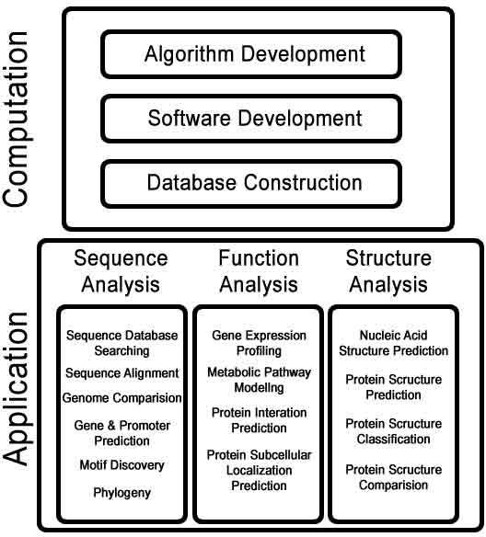
Goals of Bioinformatics
To construct and manage biological database.
To develop algorithm for different types of sequence analysis.
To develop softwares.

Slide 9
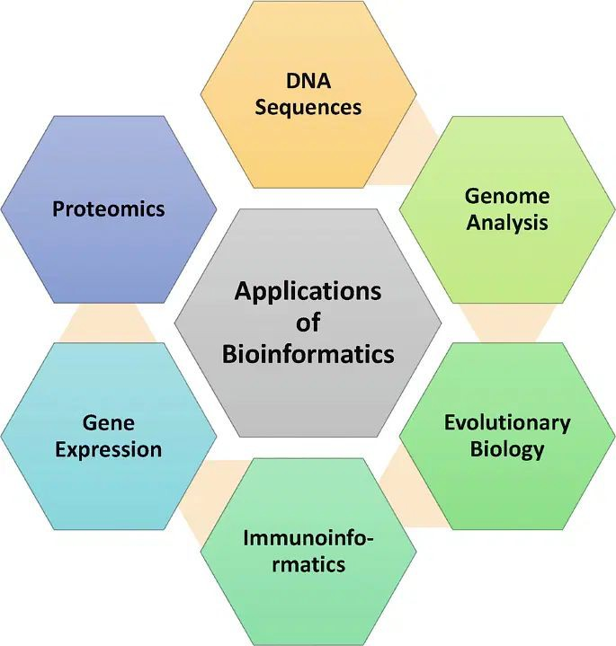
Applications of Bioinformatics
Bioinformatics is about analyzing huge biological datasets to find important facts, which are then processed and interpreted to help in science and medicine. It's like turning unorganized raw data into meaningful insights.
One major area is 3D image processing and modeling of living cells, which enables scientists to visualize cellular structures in high resolution and simulate their behavior in virtual environments.
The most important application of bioinformatics can be seen in the field of medicine, where its data is used to create antidotes for infectious and harmful diseases.

Slide 10
Uses of Bioinformatics
Bioinformatics is used in various fields, especially in biomedicine where it has various applications.
Drug discovery: By the use of structure-based drug design with Bioinformatics, scientists can come up with effective drugs for various illnesses and acute diseases.
Personalized medicine: By assessing the genetic structure of the patient and their respective medical history, personalized medicine can be curated which would prove to be much more effective.
Preventive medicines: This is primarily achieved by integrating data from bioinformatics, bioanalytics, and epidemiology. As the name suggests, preventive medicine focuses on interrupting the chain of disease transmission or mitigating acute conditions before their onset. By leveraging computational analyses, biological measurements, and population-level health data, preventive approaches can predict risks, design early interventions, and reduce the overall burden of disease.

Slide 11
Uses of Bioinformatics
Bioinformatics is used in various fields, especially in biomedicine where it has various applications.
Gene therapy: Gene therapy is the process where defective genes are replaced by new ones in the gene structure of a living organism. Since each organisms gene structure is very different, huge data may be involved to produce an accurate replacement.

Slide 12
Why is Bioinformatics important for CSE students?
Why you, as a CSE student, should study Bioinformatics?
1. It’s CS applied to real, high-impact problems
Bioinformatics uses:
Algorithms & data structures
Databases
Machine learning
Big data & cloud computing
…but instead of toy problems, you solve real problems like:
Disease detection
Drug discovery
Genome analysis

Slide 13
Why is Bioinformatics important for CSE students?
2. Biology today is a data science problem
Modern biology generates terabytes of data (DNA sequences, RNA-seq, protein data).
Biologists cannot analyze this alone
They need CSE people to design:
  Efficient algorithms
  Fast search techniques
  Scalable systems
Think of DNA as a very long string → classic CS problem.

Slide 14
Why is Bioinformatics important for CSE students?
3. Strong career advantage (interdisciplinary edge)
With bioinformatics, a CSE student can work as:
Bioinformatics Engineer
Computational Biologist
Healthcare Data Scientist
AI Engineer in biotech / pharma
These roles are:
High demand
Research-oriented
Well-paid globally

Slide 15
Why is Bioinformatics important for CSE students?
4. Perfect fit if you like ML, AI, and Data Science
Bioinformatics is one of the best application areas for:
Machine Learning
Deep Learning
Pattern recognition
Examples:
Predicting diseases from gene data
Cancer classification using gene expression
Protein structure prediction (AI + biology)

Slide 16
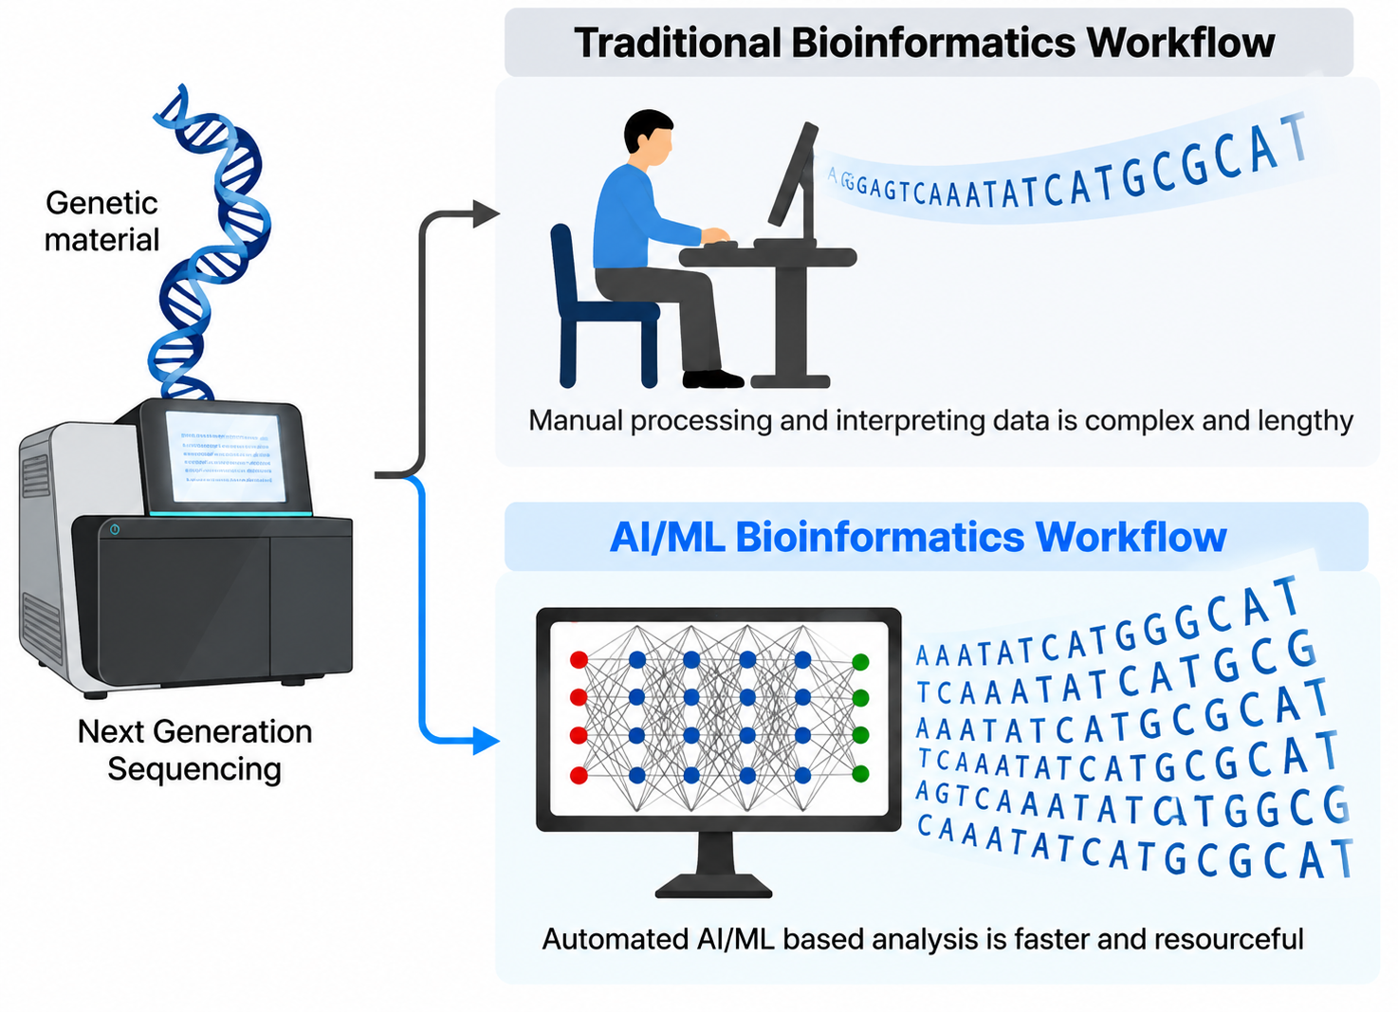

Slide 17
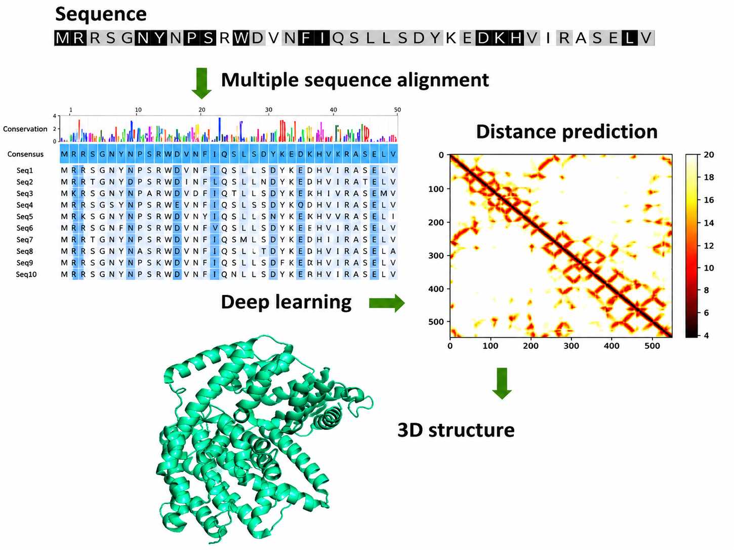

Slide 18
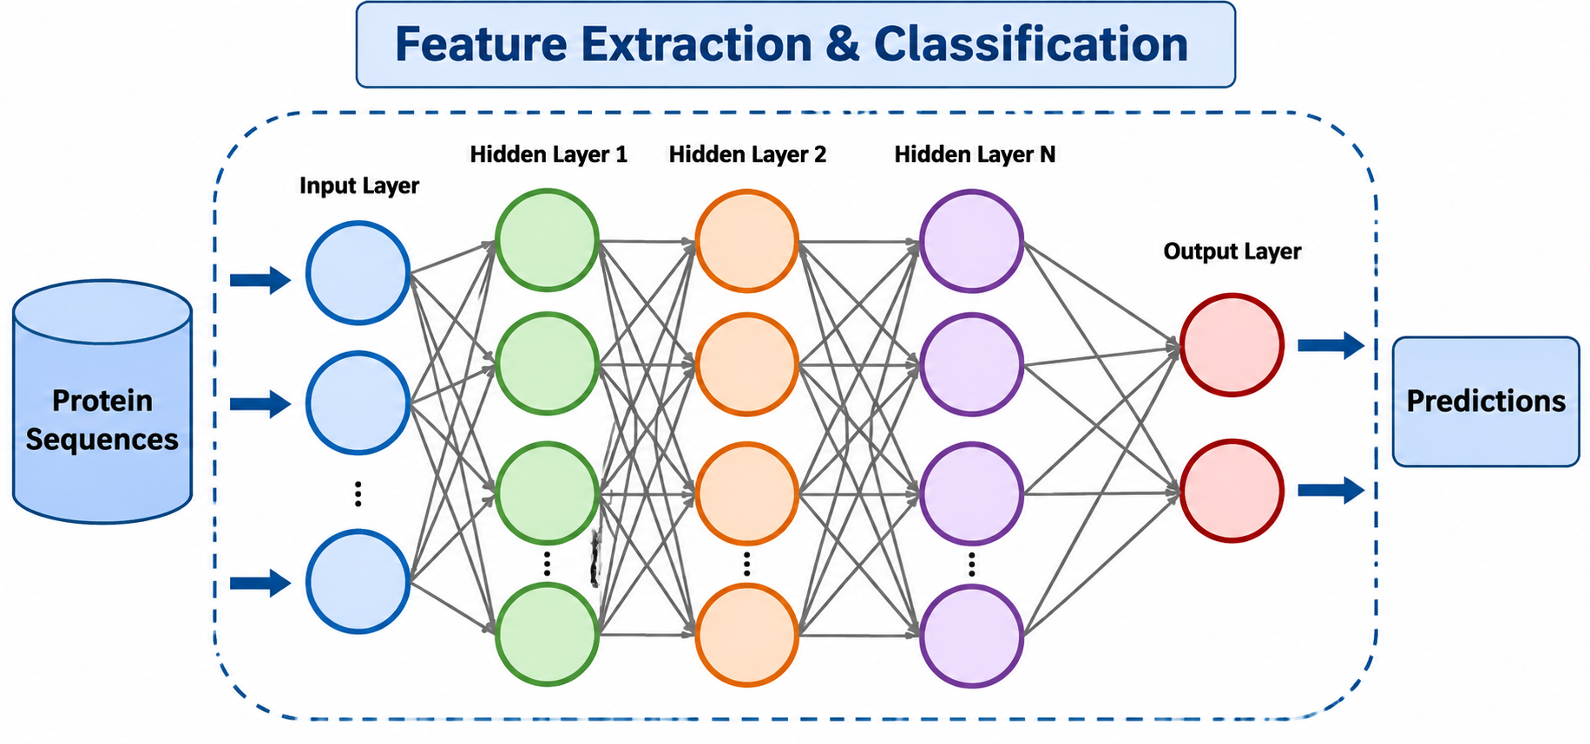

Slide 19
Why is Bioinformatics important for CSE students?
5. Research & higher studies advantage
If you plan:
MS / PhD
Research publications
International scholarships
Bioinformatics makes your profile stand out, because:
It shows interdisciplinary thinking
Many funded projects are in bioinformatics + AI

Slide 20
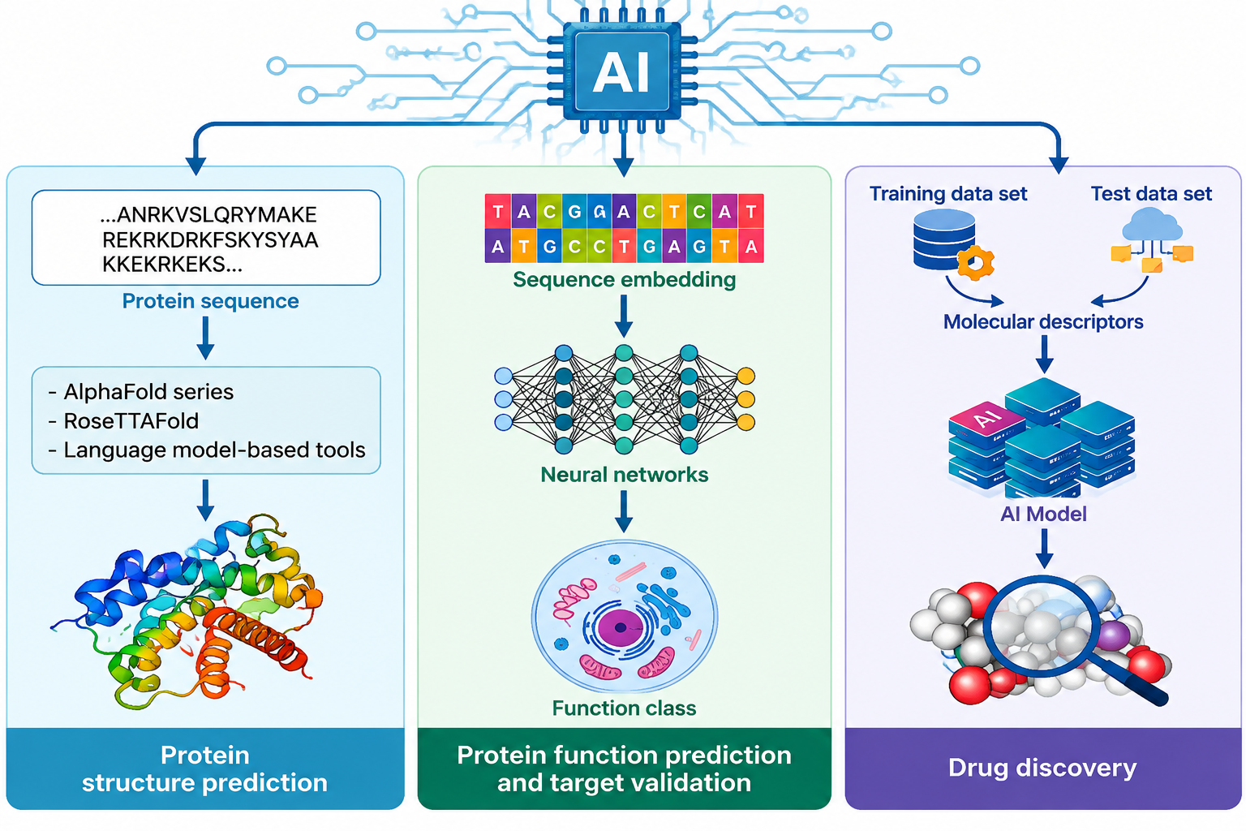

Slide 21
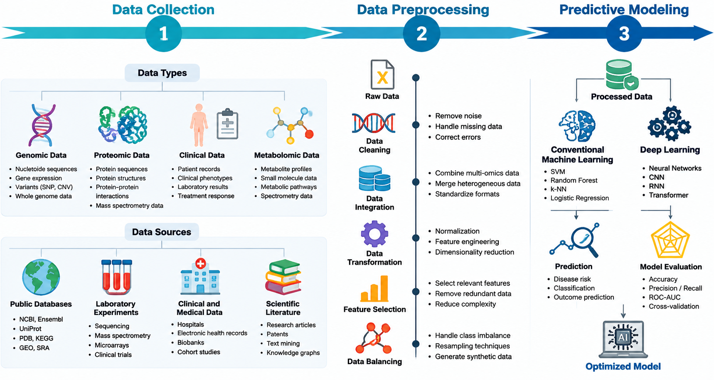

Slide 22
Why is Bioinformatics important for CSE students?
6. You don’t need to be a biology expert
This is important 👇
As a CSE student:
You learn only the required biology
Focus is on computation, algorithms, and analysis
Biology is treated like domain knowledge, not memorization

Slide 23
Bioinformatics in Machine Learning and AI
Bioinformatics is the field where biology + computer science + data analysis are combined to study biological data such as DNA sequences, proteins, genes, and diseases.
With the growth of Machine Learning (ML) and Artificial Intelligence (AI), bioinformatics has become one of the most important AI application areas.

Slide 24
Role of Machine Learning in Bioinformatics
Biological data are extremely large and complex. ML algorithms help computers identify patterns that humans cannot easily detect.
Examples:
a) Genomic Analysis
DNA contains millions of genetic variations.
ML models analyze genome sequences to:
  identify disease-related mutations
  predict genetic disorders
  classify cancer types
Example:
A deep learning model can analyze a patient's genome and predict the risk of diseases like cancer or diabetes.

Slide 25
Role of Machine Learning in Bioinformatics
b) Protein Structure Prediction
Proteins are essential molecules in the body, but understanding their 3D structure is difficult.
AI models can predict:
  amino acid sequence → protein structure
  protein function
  protein interactions
Example:
Google DeepMind developed AlphaFold, which uses deep learning to predict protein structures with high accuracy.

Slide 26
Role of Machine Learning in Bioinformatics
c) Drug Discovery Using AI
Traditional drug discovery can take 10–15 years and billions of dollars.
AI helps by:
  Finding disease-related targets
  Designing new drug molecules
  Predicting drug effectiveness
  Predicting toxicity and side effects
Workflow:
Disease data → AI model → Candidate drug → Laboratory testing → Clinical trial

Slide 27
Role of Machine Learning in Bioinformatics
d
d) Disease Diagnosis
AI analyzes:
  medical images
  genetic data
  patient records
  biomarkers
Applications:
  cancer detection
  Alzheimer's disease prediction
  infectious disease identification

Slide 28
AI Techniques Used in Bioinformatics
Machine Learning Methods
1. Supervised Learning
Uses labeled biological data.
Example:
  Predicting whether a gene mutation causes disease.
Algorithms:
  Support Vector Machine (SVM)
  Random Forest
  Logistic Regression

Slide 29
AI Techniques Used in Bioinformatics
2. Unsupervised Learning
Finds hidden patterns in biological data.
Example:
  Grouping patients into different cancer subtypes.
Algorithms:
  K-means clustering
  PCA

Slide 30
AI Techniques Used in Bioinformatics
3. Deep Learning
Uses neural networks to analyze complex biological data.
Applications:
  DNA sequence prediction
  Protein folding
  Medical image analysis
Models:
  CNN (Convolutional Neural Network)
  RNN (Recurrent Neural Network)
  Transformer models

Slide 31
Future of AI in Bioinformatics
Future developments include:
AI-designed medicines
Personalized healthcare
Faster vaccine development
Digital twins of patients
AI-assisted genetic engineering
Early disease prediction

Slide 32
Areas Where Bioinformatics is Applied!
Genomics:
★ Sequencing data analysis
★ Genomic feature prediction
Proteomics:
★ Protein 3D structure modeling
★ Drug design
System Biology:
★ Genome set enrichment
★ Pathway analysis
Phenotype:
★ Image analysis
★ Integration

Slide 33
What is the purpose of Bioinformatics?
The work of bioinformatics is in the processing of large amount of data.
The purpose of bioinformatics is to make sense of processes taking place inside organism or living systems.

Slide 34
Conventional Biology
Focuses on wet-lab experiments (microscope, petri dish, DNA extraction, etc.).
Studies living organisms directly (cells, tissues, plants, animals, microbes).
Example activities:
  Observing bacteria under a microscope.
  Doing DNA sequencing in a lab.
  Conducting breeding experiments with plants.

Slide 35
Bioinformatics
Focuses on computer-based analysis of biological data.
Uses algorithms, databases, and statistical tools to study biology.
Handles large-scale data (like DNA sequences, protein structures, gene expression data).
Example activities:
  Comparing DNA sequences across species using software.
  Predicting protein structures with algorithms.
  Analyzing gene expression patterns in cancer research.

Slide 36
How is Bioinformatics Different from Conventional Biology
Drawbacks of conventional biology
★ High resource requirement: conventional research generally requires a sophisticated lab to work in and may also need expansive utilities and model organisms.
★ The experiments are normally long, delicate and sometimes risky to the researchers
Let’s take an example of drug discovery of a disease and see it in both ways: conventional biological approach and bioinformatic approach.

Slide 37
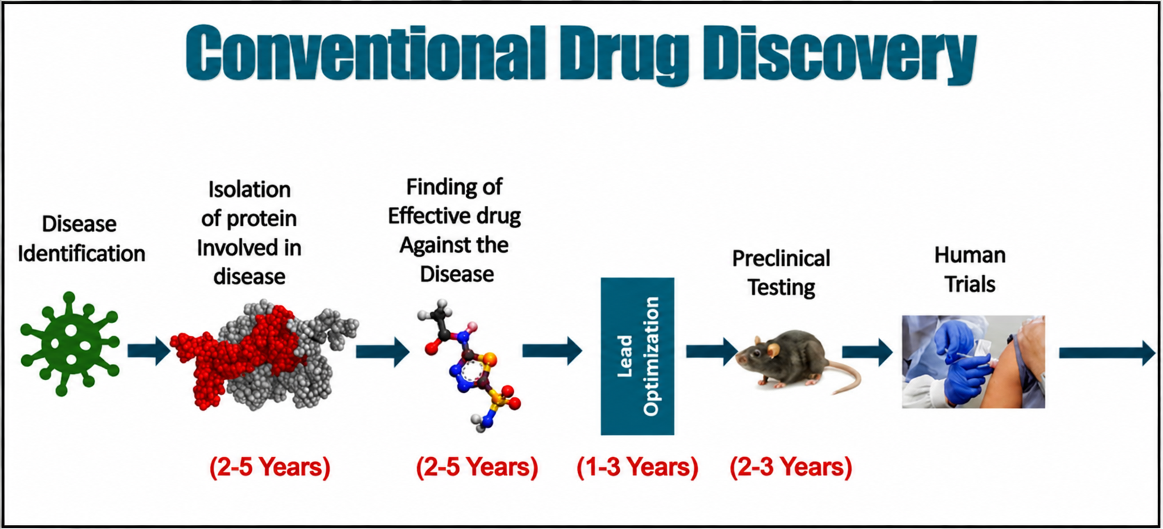
How is Bioinformatics Different from Conventional Biology
Conventional approach is lengthy, expansive and risky with high failure rate.

Slide 38
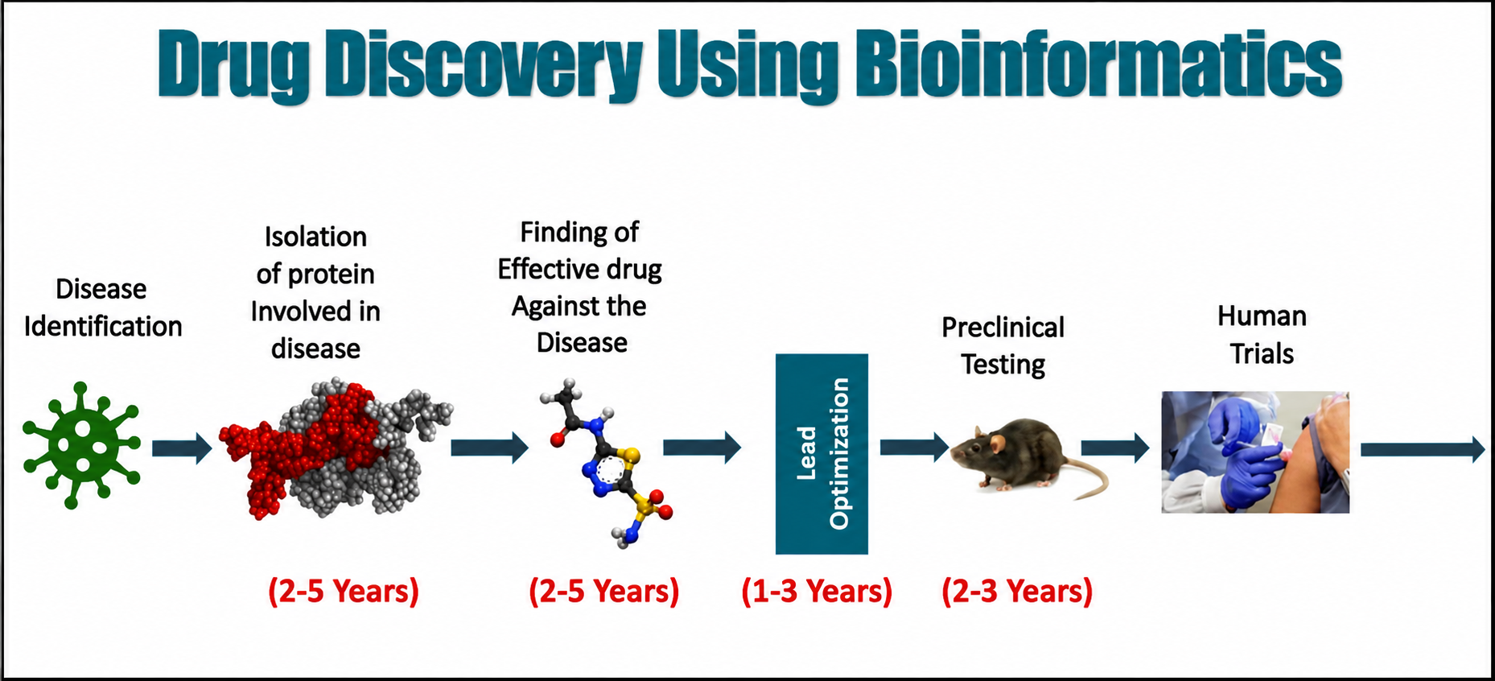
How is Bioinformatics Different from Conventional Biology
5–8 years (sometimes faster)

Slide 39
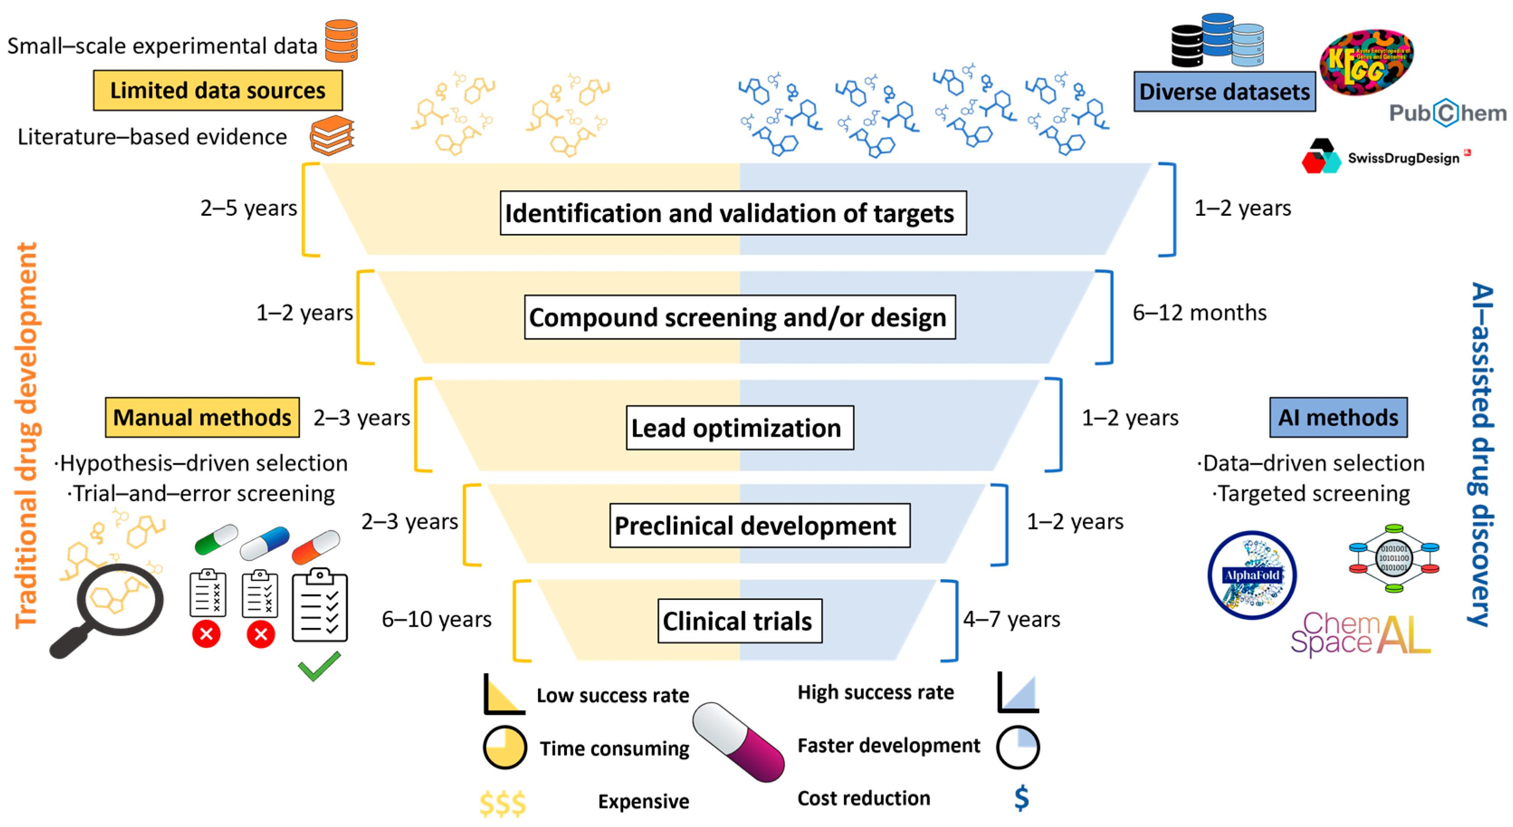

Slide 40
Biological Database
These are the databases consisting of biological data like protein sequencing, molecular structure, DNA sequences, etc in an organized form.
Several computer tools are there to manipulate the biological data like an update, delete, insert, etc. Scientists, researchers from all over the world enter their experiment data and results in a biological database so that it is available to a wider audience.
Biological databases are free to use and contain a huge collection of a variety of biological data.

Slide 41
Uses of Biological Database
It helps the researchers to study the available data and form a new thesis, anti-virus, helpful bacteria, medicines, etc.
It helps scientists to understand the concepts of biological phenomena.
Secondary databases have become the molecular biologist’s reference library over the past decade or so, providing a wealth of information on just about any gene or gene product that has been investigated by the research community.
The database acts as a storage of biological information.
It helps remove the redundancy of data.

Slide 42
Types of Biological Database
There are basically three types of biological databases. They are: Primary databases, secondary databases and composite databases.
Primary Databases
Stores raw, experimental data that comes directly from laboratory experiments without much interpretation.
Nature: Original, unprocessed, factual data.
Examples:
  GenBank (DNA sequences – maintained by NCBI)
  EMBL-EBI (European Molecular Biology Laboratory database)
  DDBJ (DNA Data Bank of Japan)
  PDB (Protein Data Bank – protein 3D structures)
✅ Example use: Uploading a newly sequenced gene into GenBank so others can access the raw sequence.

Slide 43
Types of Biological Database
Primary Databases
Accession Number in Bioinformatics
A unique identifier assigned to each entry (sequence, structure, or dataset) when it is submitted to a primary or secondary database.
No two records share the same accession number.
Once assigned, it never changes, even if the entry is updated or corrected.
Purpose: Ensures reliable referencing, retrieval, and citation of biological data.
Examples:
GenBank (NCBI)
  Example accession: NM_000546 (human TP53 mRNA sequence).
PDB (Protein Data Bank)
  Example accession: 1A3N (a protein 3D structure).

Slide 44
Types of Biological Database
Secondary Databases
Stores interpreted, curated, or derived data that is analyzed and annotated from primary databases.
Nature: Processed, predicted, or categorized information.
Examples:
  Pfam (protein families and domains)
  Prosite (protein motifs and patterns)
  InterPro (integrated protein classification)
  SCOP (Structural Classification of Proteins)
  Swiss-Prot (UniProtKB/Swiss-Prot) (manually annotated protein sequences)
✅ Example use: Using Pfam to find which family a protein belongs to, based on sequences from primary databases.

Slide 45
Types of Biological Database
Composite Databases
A composite database is created by integrating data from multiple primary databases into a single, non-redundant, and more user-friendly resource.
It collects raw sequence data (from primary sources).
Removes duplicates and inconsistencies.
Provides a consolidated dataset for easier searching and analysis.
Why needed?
Primary databases (like GenBank, EMBL, DDBJ) often contain duplicate entries because the same sequence might be submitted to more than one database. A composite database solves this by merging, cleaning, and unifying the data.
Examples:
Composite Databases -OWL,NRD and Swissport +TREMBL

Slide 46
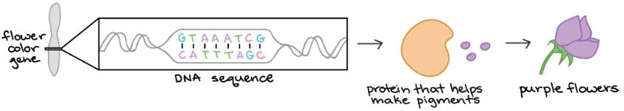
Central Dogma of Molecular Biology
The bone, skin, and muscle that we see are made up of cells. And each of these cells contains many millions of proteins. As a matter of fact, proteins are the key molecular building blocks for every organism on earth. But how are these proteins made in a cell!!!
The instructions for making proteins are written in a cell’s DNA. A DNA is not just a long string of nucleotides but is divided up into functional units called genes.
Each gene provides instructions for a functional product, that is, a molecule needed to perform a job in a cell. In many cases, the functional product of a gene is a protein.
For example, Mendel's flower color gene provides instructions for a protein that helps make colored molecules (pigments) in flower petals.

Slide 47
Quick Example: Mendel’s Flower Color Gene
DNA in the flower contains a gene for a pigment-making enzyme.
Transcription → mRNA copy of that gene.
Translation → protein (enzyme) that helps produce pigment molecules.
Result → colored flower petals.

Slide 48
Central Dogma of Molecular Biology
The central dogma states that the pattern of information that occurs most frequently in our cells is:
From existing DNA to make new DNA (DNA replication)
From DNA to make messenger RNA (Transcription)
From mRNA to make new proteins (Translation)
In transcription, the DNA sequence of a gene is copied to make an RNA molecule. This step is called transcription because it involves rewriting, or transcribing, the DNA sequence in a similar RNA "alphabet." In eukaryotes, the RNA molecule must undergo processing to become a mature messenger RNA (mRNA).
DNA alphabet = A, T, C, G
RNA alphabet = A, U, C, G

Slide 49
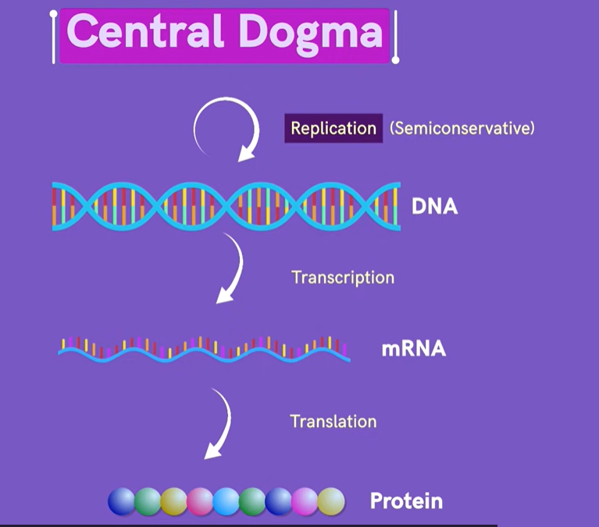

Slide 50
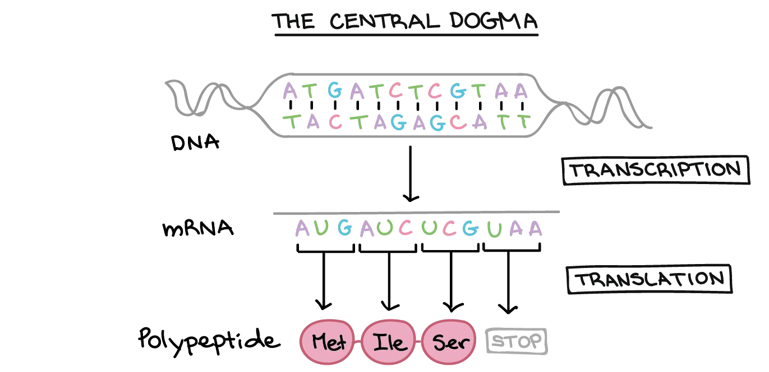
Central Dogma of Molecular Biology
In translation, the sequence of the mRNA is decoded to specify the amino acid sequence of a polypeptide. The name translation reflects that the nucleotide sequence of the mRNA sequence must be translated into the completely different "language" of amino acids.
Thus, during expression of a protein-coding gene, information flows from DNA
→RNA→protein. This directional flow of information is known as the central dogma of molecular biology. Non-protein-coding genes (genes that specify functional RNAs) are still transcribed to produce an RNA, but this RNA is not translated into a polypeptide. For either type of gene, the process of going from DNA to a functional product is known as gene
expression.
26

Slide 51
The Genetic Code
The genetic code is the set of rules that defines how the sequence of nucleotides in mRNA is translated into a sequence of amino acids in a protein.
Codons
A codon is a sequence of three nucleotides in mRNA.
Each codon specifies one amino acid (or a stop signal).
Since there are 4 nucleotides (A, U, C, G), there are 4³ = 64 possible codons.
20 commonly found in proteins
Start and Stop Codons
Start codon
  AUG → signals start of translation
  Also codes for methionine (first amino acid in most proteins)
Stop codons
  UAA, UAG, UGA → do not code for any amino acid
  Signal the end of the polypeptide chain

Slide 52
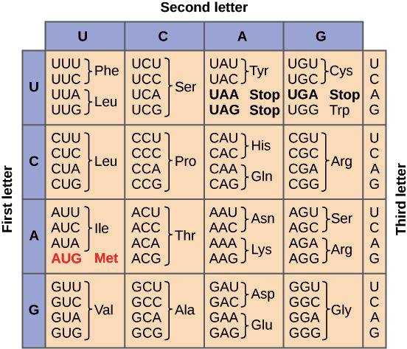
The Genetic Code

Slide 53
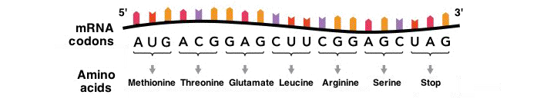
The Genetic Code
There are three more codons that do not specify amino acids. These stop codons, UAA, UAG, and UGA, tell the cell when a polypeptide is complete. All together, this collection of codon-amino acid relationships is called the genetic code, because it tells cells “decode” an mRNA into a chain of amino acids.

Slide 54
Evidence of Evolution
Evolution is the process by which species change over time, giving rise to new forms while sharing common ancestry with earlier organisms.
Four sources of evidences:
  Fossil Record
  Geographical Distribution of Related Species
  Homologous body structures
  Similarities in embryology

Slide 55
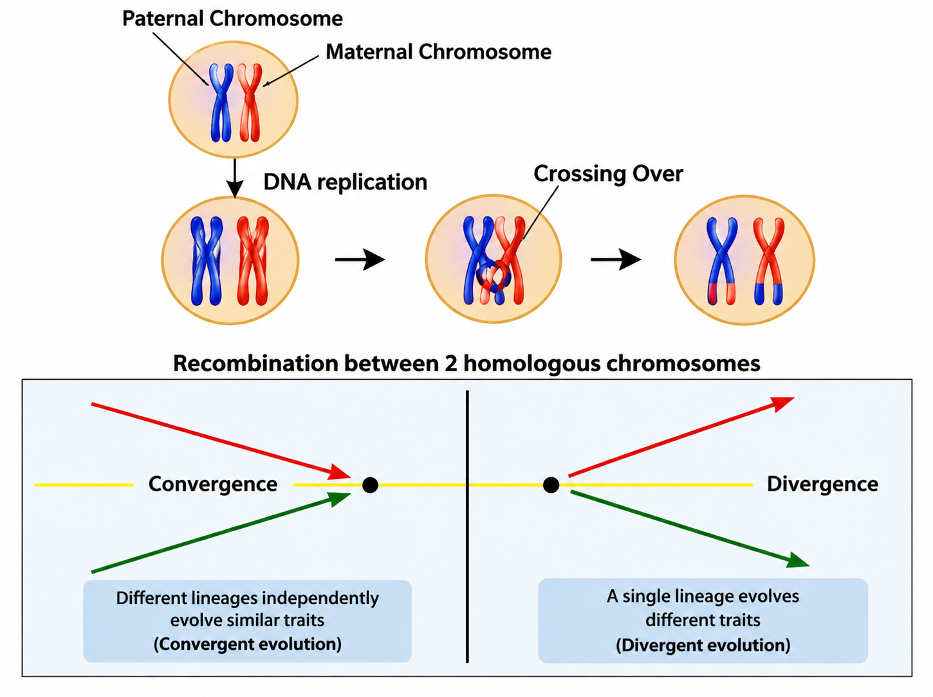
Evidence of Evolution
The mechanism through which evolution occur include:
  Natural Selection
  Mutation
  Sexual Recombination
  Divergence
  Convergence

Slide 56
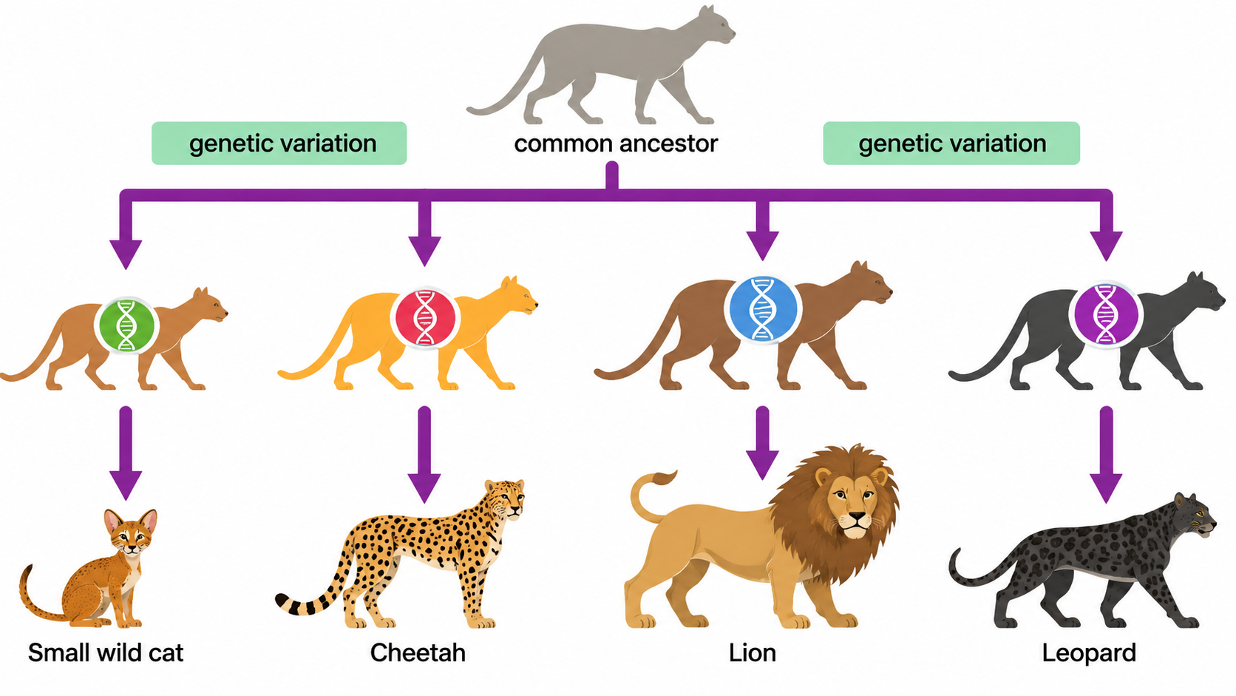
Evidence of Evolution

Slide 57
Types of Evolution
Evolution can be of several types:
  Divergent evolution
  Convergent evolution
Speciation: Divergent evolution may lead to completely new species sometimes. This is known as speciation. Speciation is the evolutionary process by which new species arise from existing ones. It often occurs when populations of the same species become isolated from one another and undergo different evolutionary pressures over time.
Divergent Evolution
When two or more species evolve from a common ancestor but adapt to different environments.
Result: Structures remain homologous (same origin, different functions).
Example: Human arm, bat wing, whale flipper.

Slide 58
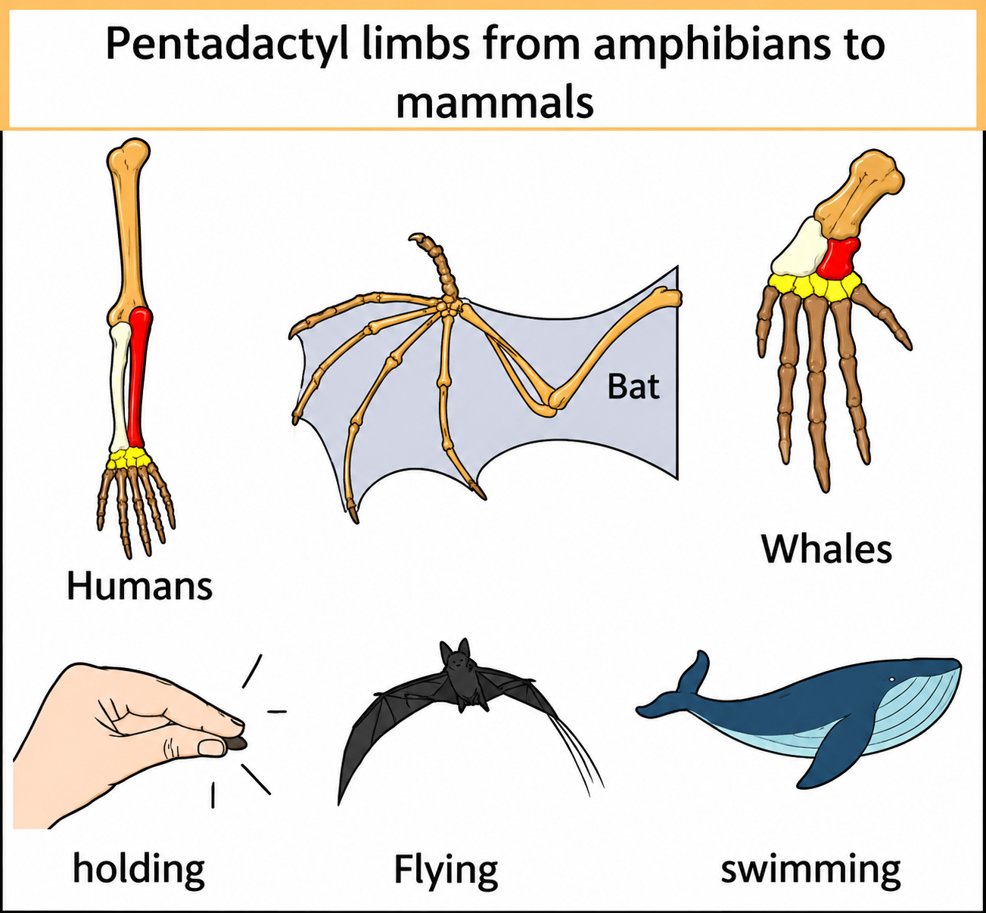
Types of Evolution (Divergent Evolution)
Here, human, bat and whales are mammals.
Homologous organs: organs with similar structure (skeletal structure or anatomy) and origin, but with different function in different organisms.
Homologous organs are developed in related animals.
Homologous organs are inherited from a common ancestor.

Slide 59
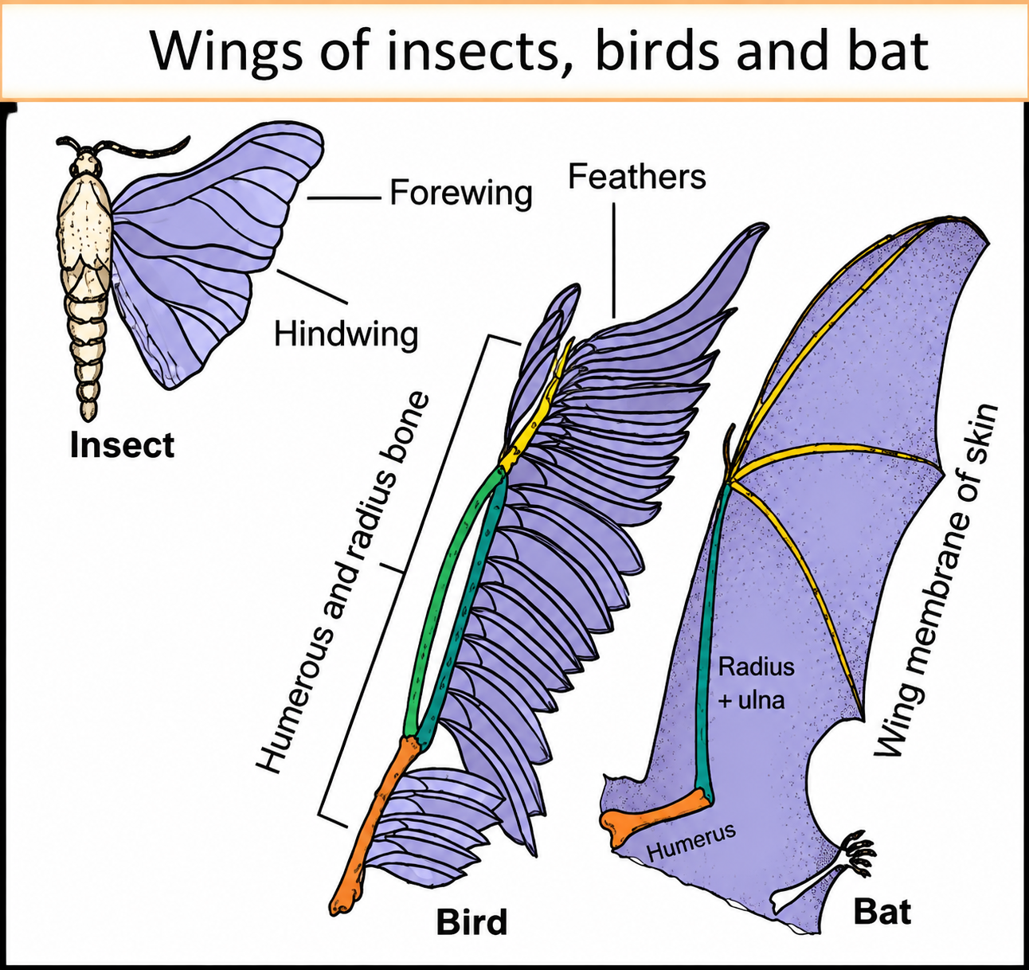
Types of Evolution (Convergent Evolution)
Convergent evolution: It is the process by which unrelated groups independently evolve similar traits to adapt to similar environment.
Analogous organs: organs with different structure (skeletal structure or anatomy) and origin, but with similar function in different organisms.
Key Features:
Different anatomy, same function
Found in unrelated animals
Evolved due to similar environments or lifestyles
Evidence of convergent evolution
Example:
Wings of bats (mammals) and insects (arthropods).
Flippers of dolphins (mammals) and sharks (fish).

Slide 60
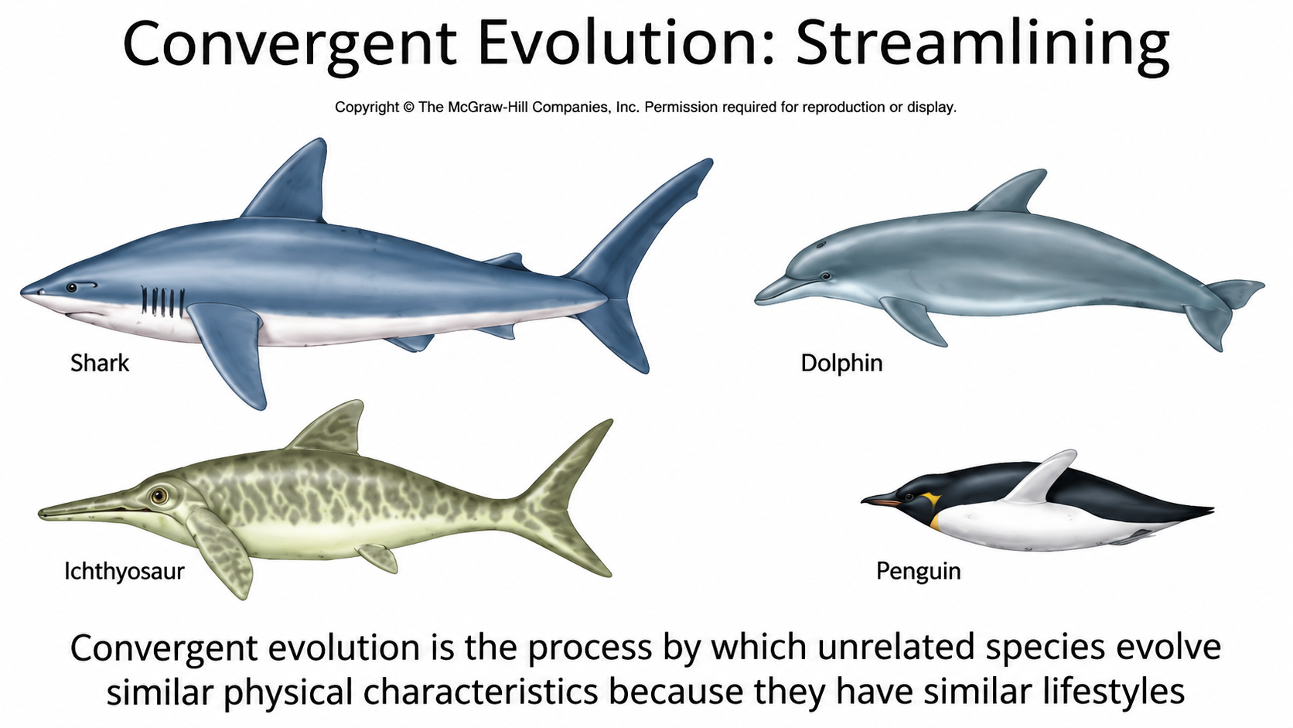
Types of Evolution (Convergent Evolution)

